Slide 1
Sequential Projection Learning for Hashing with Compact Codes
¹Jun Wang, ²Sanjiv Kumar, and ¹Shih-Fu Chang
¹Columbia University, New York, USA
²Google Research, New York, USA

Slide 2
Nearest Neighbor Search
Nearest neighbor search in large databases with high dimensional points is important (e.g. image/video/document retrieval)
Exact search not practical
Computational cost
Storage cost (need to store original data points)
Approximate nearest neighbor (ANN)
Tree approaches (KD tree, metric tree, ball tree, … )
Hashing methods (locality sensitive hashing, spectral hashing, …)
Notes:
Searching nearest neighbors is very critical for many applications in large databases, such as image/video, and documents retrieval. Exact nearest neighbors search is not practical due to both computation cost and storage cost. Fortunately, in real situations, it is good enough to finding the approximate nearest neighbors, that is ANN. There are two categories of ANN search techniques, tree based and hashing based. But tree based approaches still have memory constraints and sometimes can not work well for high dimensional data. Therefore, we focus on hashing approach in our work.

Slide 3
Binary Hashing
Hyperplane partitioning
Linear projection based hashing
h₂
h₁
X | x₁ | x₂ | x₃ | x₄ | x₅
x₁
h₁ | 0 | 1 | 1 | 0 | 1
x₃
h₂ | 1 | 0 | 1 | 0 | 1
x₄
… | … | … | … | … | …
h_{k} | … | … | … | … | …
x₂
x₅
010…
100…
111…
001…
110…
Notes:
Here is one possible way to generate binary hashing codes based on linear projections. For each hash bit, a certain hyperplan is drawn and partition the data into two sections. The left part is assigned hash value zero and the right section is assigned with 1. Similarly, the hyperplan h2 generates another hash bit. If do it over and over, you can create K-bit hash codes.
A general form of linear projection based hashing is listed here.

Slide 4
Related Work
Different choices of projections
random projections
locality sensitive hashing (LSH, Indyk et al. 98)
shift invariant kernel hashing (SIKH, Raginsky et al. 09)
principal projections
spectral hashing (SH, Weiss, et al. 08)
Different choices of
identity function: LSH & Boosted SSC (Shakhnarovich, 05)
sinusoidal function: SH & SIKH
Other recent work:
Restricted boltzman machines (RBMs, Hinton et al. 06)
Jian et al. 08 (metric learning)
Kulis et al. 09 & Mu et al. 10 (kernerlized)
Kulis NIPS 09 (binary reconstructive embedding)
Notes:
Starting from the general form of hash functions, there are many approaches haven been developed. First, we can choose different projections. For example, LSH and shift invariant kernel hashing use random projections. SH uses principal projections. Second, we can choose different forms of function f. LSH and Boosted SSC uses identity functions and SH and SIKH use sinusoidal function.

Slide 5
Main Issues
Existing hashing methods mostly rely on random or principal projections
not compact
low accuracy
Simple metrics are usually not enough to express semantic similarity
Similarity given by a few pairwise labels
Goal: to learn binary hash functions that give high accuracy with compact codes
--- semi-supervised and unsupervised cases
Notes:
Now the question is what is the main issues of these proposed methods.

Slide 6
Formulation
x₁
x₂
x₃
x₄
x₅
x₆
x₇
x₈
x₁
x₂
x₃
x₄
x₅
x₆
x₇
x₈
Notes:
Here is the formulation of our hash learning method. We use the very simple hash form by setting f as identity function. It is just projection followed by thresholding. In our case, we use mean partition. If assume the data zero centered, the thresholding is just zero partitioning.

Slide 7
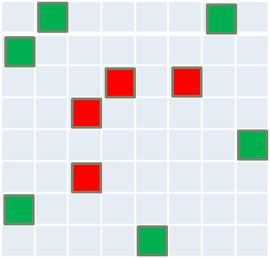
Formulation - Empirical Fitness
# of wrongly hashed pairs
# of
# of
# of correctly hashed pairs
Notes:
Now I introduce the empirical fitness.

Slide 8
Empirical Fitness
How well the hash codes fit on the training data
Recall the definition of pair-wise label metric
Objective:

Slide 9
Relaxing Empirical Fitness
Replace the sign of projections with the signed magnitude
A more simplified matrix form as:

Slide 10
Information Theoretic Regularizer
Maximizing empirical fitness is not sufficient
Maximizing the combination of empirical fitness over training data and entropy of hash codes
1
Neighbor pair
-1
1
-1
Non-neighbor pair
Maximum entropy principle

Slide 11
Relaxing Regularization Term
Step 1: Maximum entropy equals balanced partition
Step 2: Balanced partition equals partition with maximum variance
Step 3: Substitute the maximum bit-variance term by its lower bound

Slide 12
Final Objective
Orthogonal solution by Eigen-decomposition on adjusted covariance matrix M
“adjusted” covariance matrix
Not very accurate!

Slide 13
Sequential Solution
Motivation: to learn a new hash function which tries to correct the mistakes made by previous hash function

Slide 14
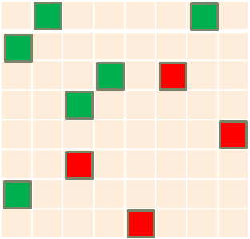
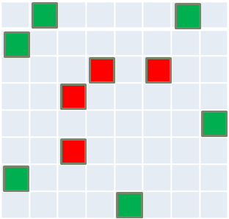
Update Label Matrix
Impose higher weights on point pairs violated by the previous hash functions

Slide 15
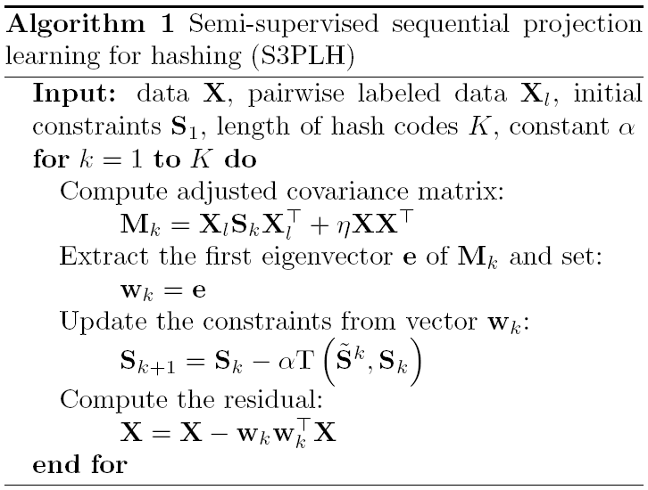
S3PLH Algorithm Summary

Slide 16
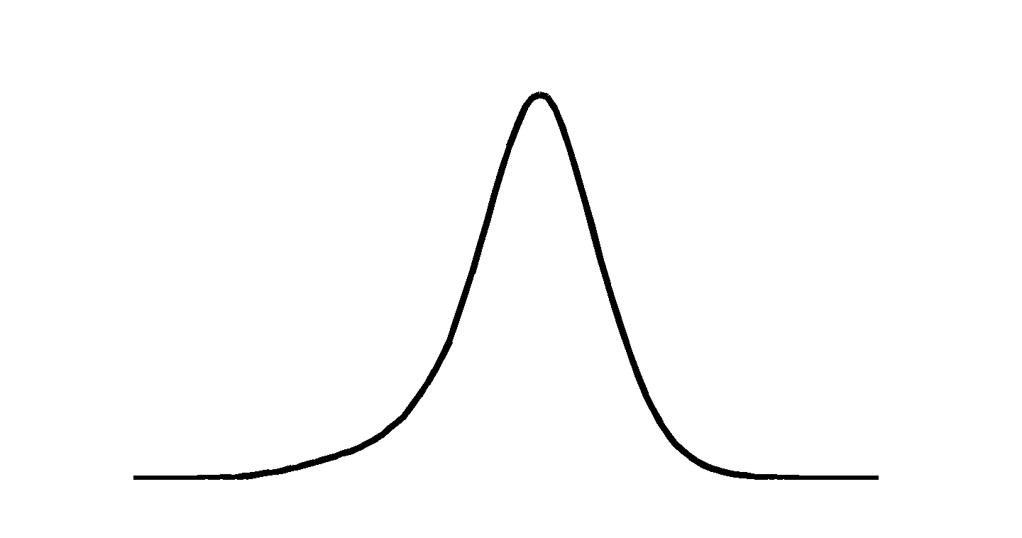
Unsupervised Extension (USPH)
Observation - boundary errors
Notes:
Now we show how to extend the sequential learning idea to unsupervised case. Remember the key idea of sequential learning is to detect errors based on the given pair wise labels and design a new hash function to correct these errors. Clearly for unsupervised cases, there are no pair wise labels for detect the errors directly.

Slide 17
Pseudo Pair-Wise Labels
Pseudo set of labeled data from
contains all the point pairs:
Accordingly, generate a pseudo label matrix
Different with SPLH, USPLH generates new pseudo labels and the corresponding label matrix, instead of updating weights of a fixed set of given labels.

Slide 18
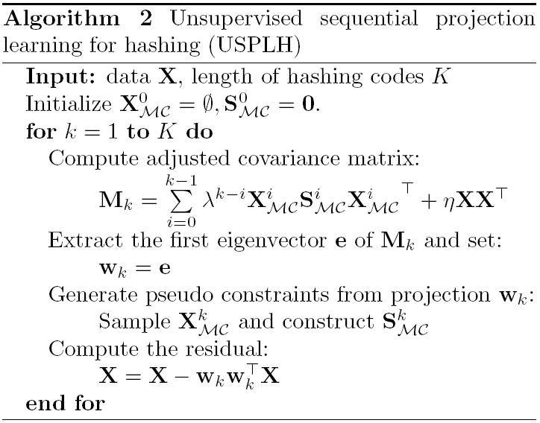
USPLH Algorithm Summary
35

Slide 19
Experiments
Datasets
MNIST (70K) – supervised case
SIFT Data (1 Million SIFT features) – unsupervised case
Evaluation protocol
Mean Average Precision and Recall
Setting of training:
MNIST data
semi-supervised: 1K labeled samples for training, 1K for query test
SIFT Data
unsupervised: 2K pseudo labels for training, 10K for query test

Slide 20
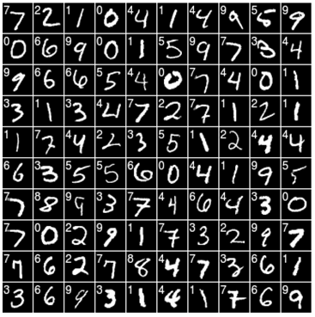
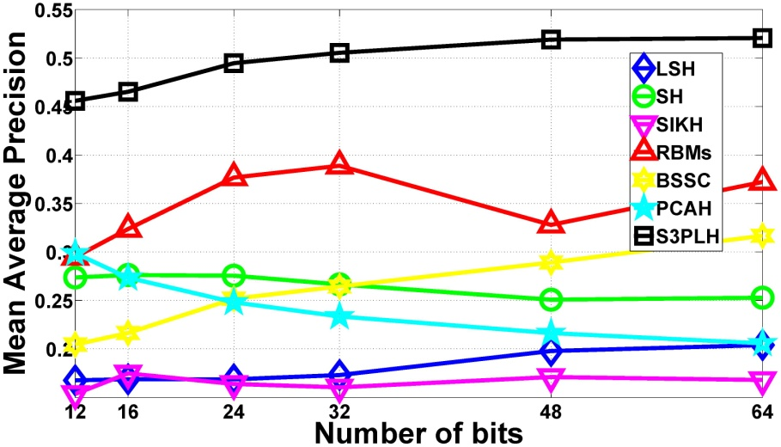
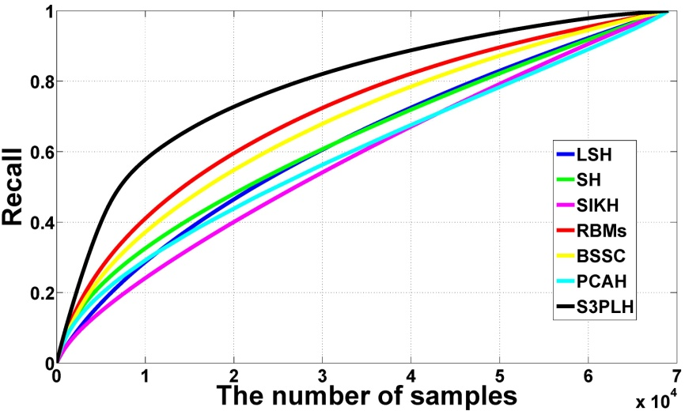
MNIST Digits
48-bit Recall curve

Slide 21
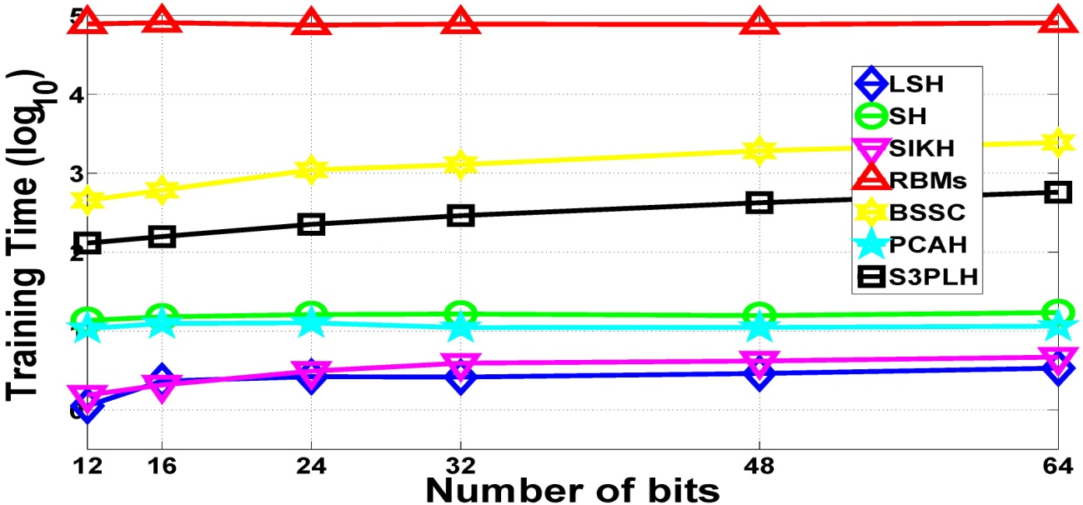
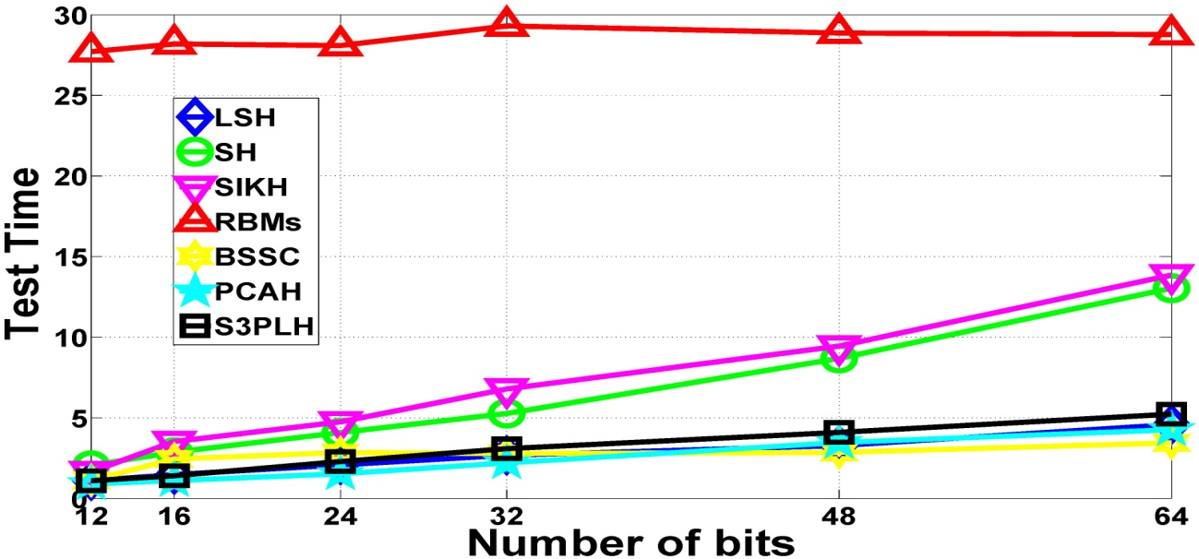
Training and Test Time

Slide 22
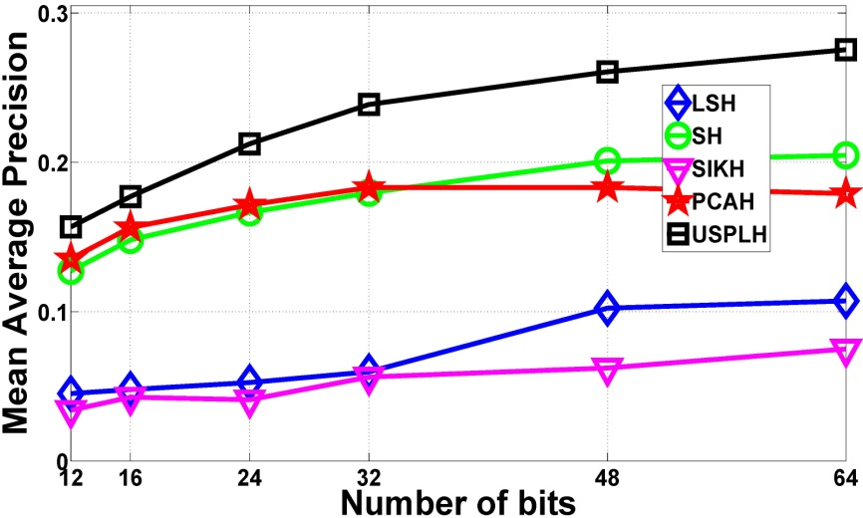
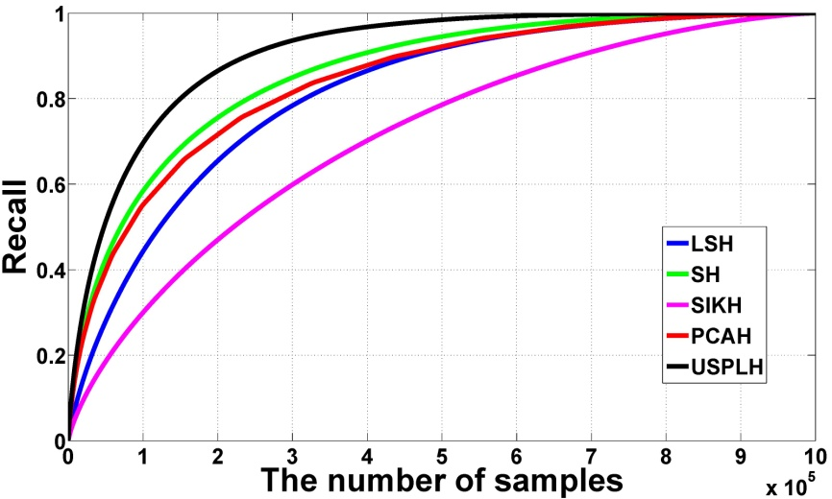
SIFT 1 Million Data
48-bit Recall curve

Slide 23
Summary and Conclusion
Summary and contributions
A semi-supervised paradigm for hashing learning (Empirical risk with information theoretic regularization);
Sequential learning idea for error correction;
Extension of unsupervised case;
Easy implementation and highly scalable;
Future work
Theoretical analysis of performance guarantee
Weighted hamming embedding

Slide 24
Thank you!

