Slide 1
Exploring Multi-Granular News Events (Broadcast Video + Curated Web)
Joe Ellis
Brendan Jou
Hongzhi Li
Dan Morozoff-Abezgauz
Shih-Fu Chang

Slide 2
News Rover’s Unique Capabilities
Event-based organization of news content
Video-based events
Wikipedia-based events
Broadcast television news aggregation
Analysis of “Major Players” in news events

Slide 3
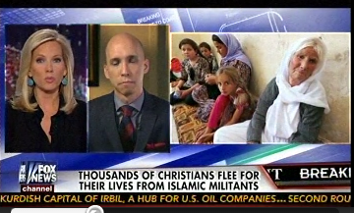
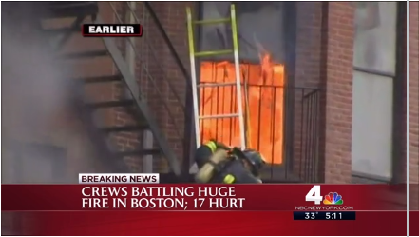
Two Types of News Events
Long Running News Event : ”2014 Northern Iraq Offensive”
Civilians Fleeing
Report of Killings
U.S. Airstrikes
Breaking News Events
Breaking News Event
A specific event at a particular moment in time.
Long Running News Event:
A collection of related events and commentary that occurs over a longer span of time.
Local News Event
Boston Building on Fire

Slide 4
News Rover Events
Video-Based Events
Wikipedia-Based Events
Address the need for coverage of breaking news events, and one-off stories that are not covered by curated news sources.
Addresses the need for coverage of long-term news stories that pertain to a broad topic or unify many smaller news events.
Real Examples
Real Examples
Ebola Patient Treated in NYC
2014 Northern Iraq Offensive
Isreal-Hamas Cease Fire Voided
2014 West Africa Ebola Outbreak
Historic New York Snow Storm
Pro-Russian Conflict in Ukraine
New U.S. Airstrikes in Iraq
Israel-Gaza Conflict

Slide 5
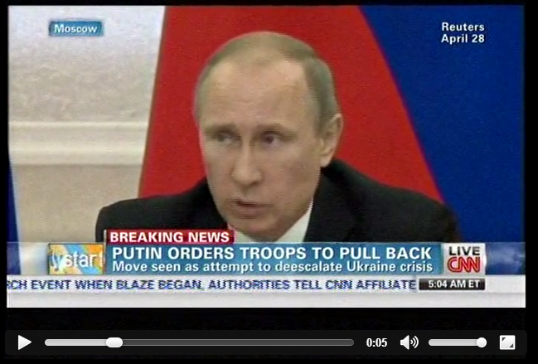
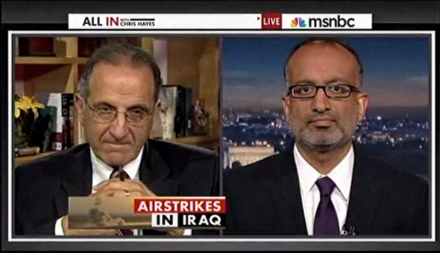
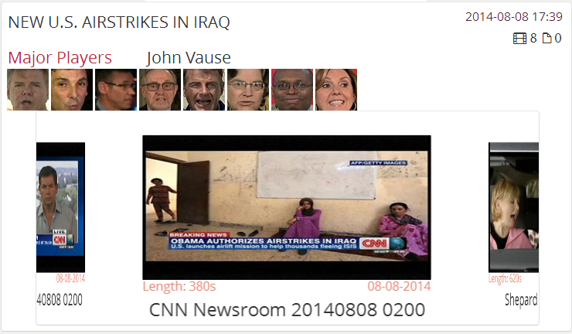
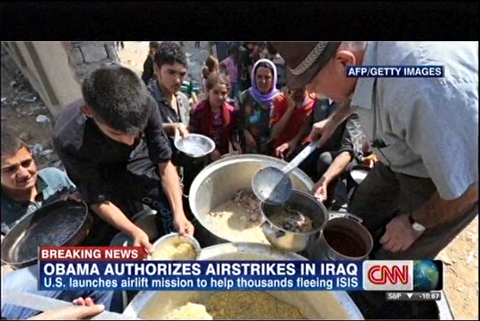
Video-Based News Events
Find Candidate Events
Extract OCR Text as Video Feature
Detect key phrases on-screen
Cluster News Videos Based
on Temporal and Text Similarity
Generate News Rover Video Event

Slide 6
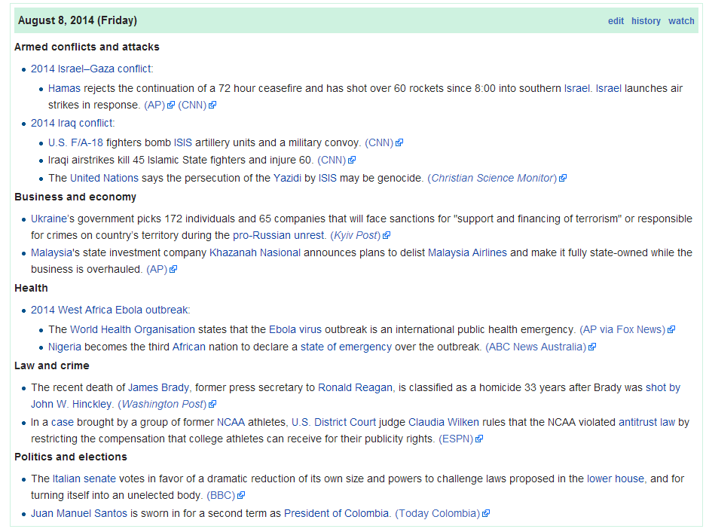
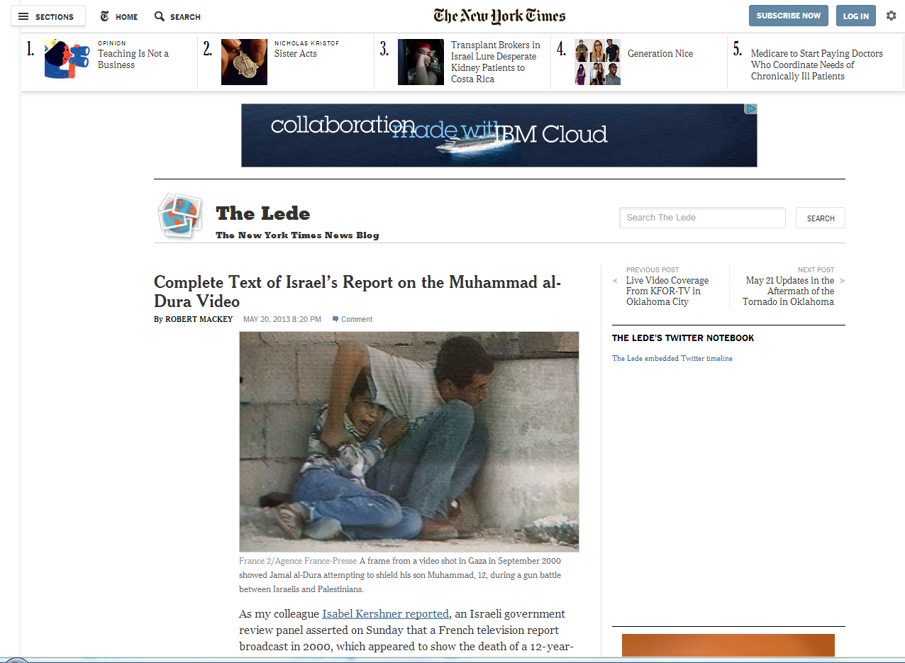
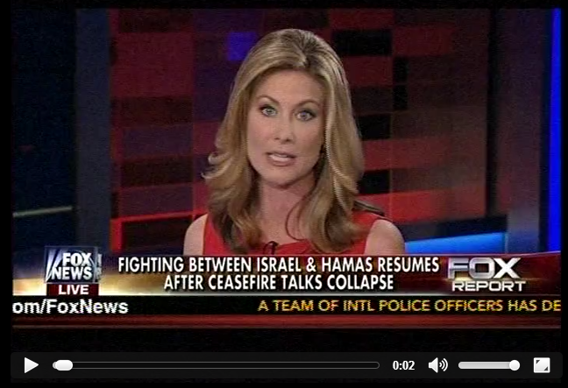
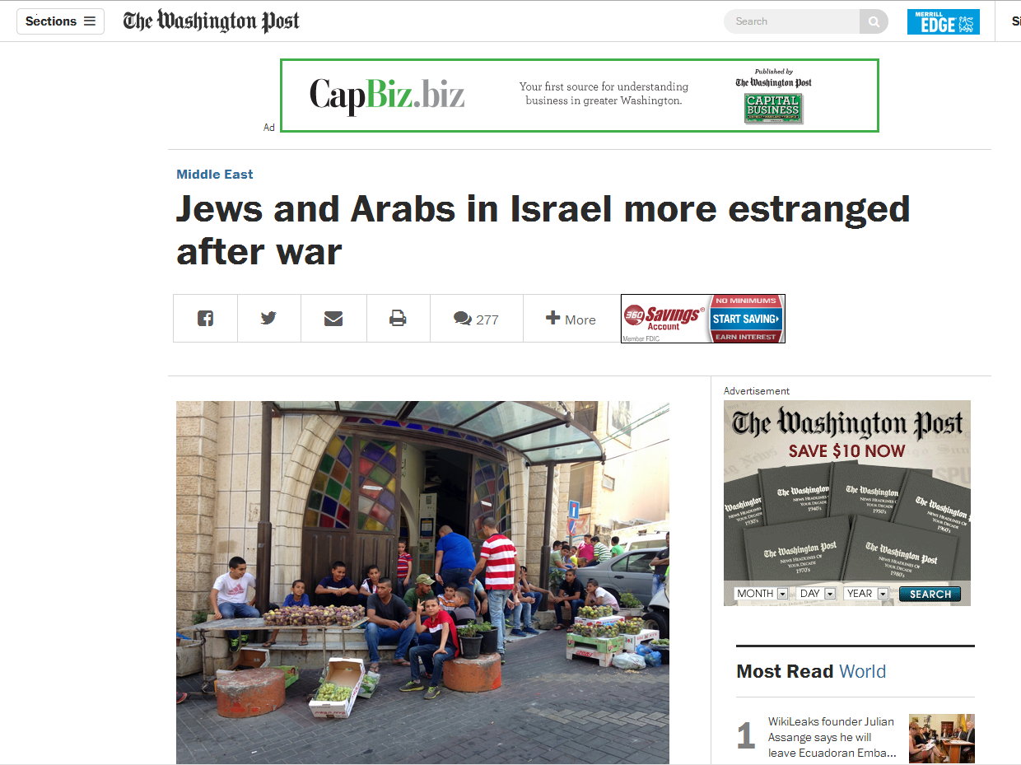
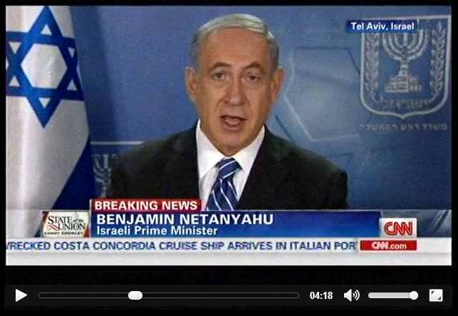
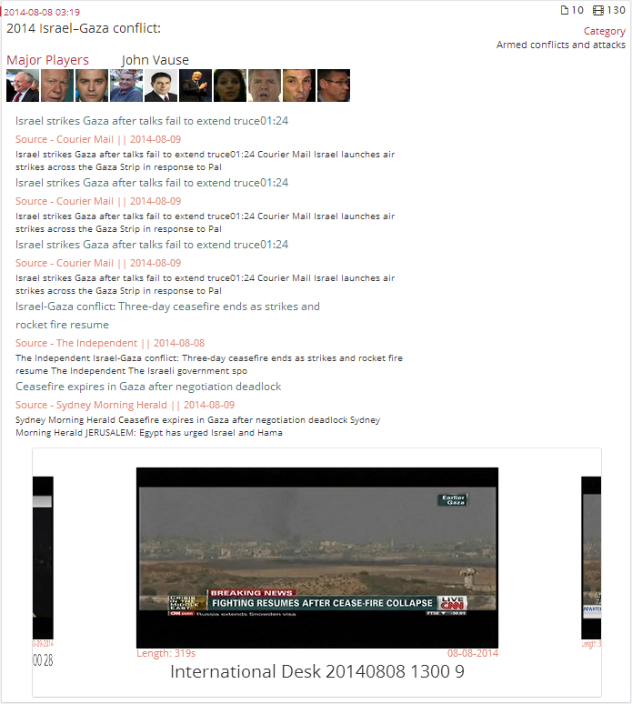
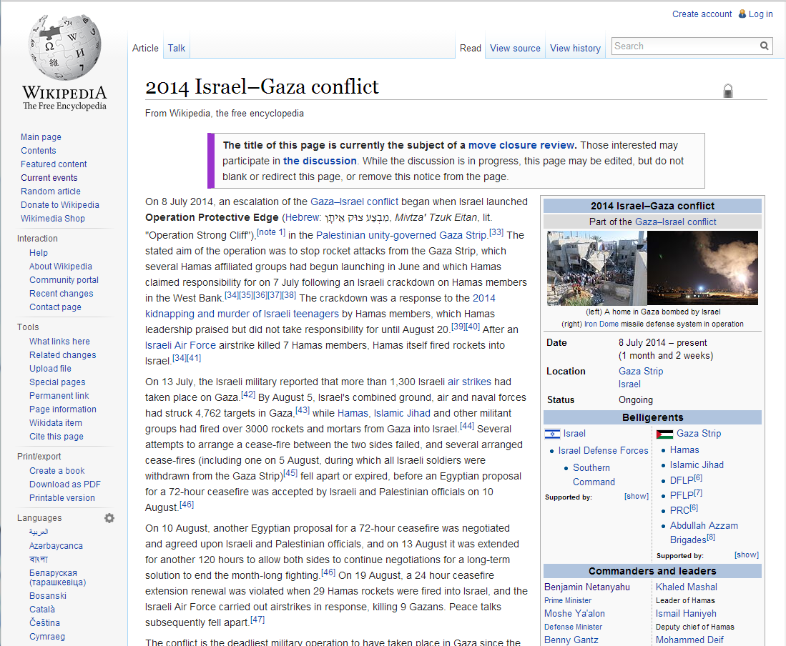
Wikipedia-Based News Event
Event Discovery
News Rover Content
Wikipedia Current Events Page
Articles
Videos
Extracted Features
Generate Wikipedia Event
Article Text
Event Description
Related Wikipedia Article
Link News Content based on Temporal and Text Similarity

Slide 7
Differences in Event Types
Video Events
Wikipedia Events
Video Event Characteristics
Specific event in time
Contain less videos than Wiki Events
Videos very closely related
Do not persist over time
Wikipedia Event Characteristics
Consists of articles and videos
Can contain many videos
Videos are loosely related
Can persist for months or days at a time

Slide 8
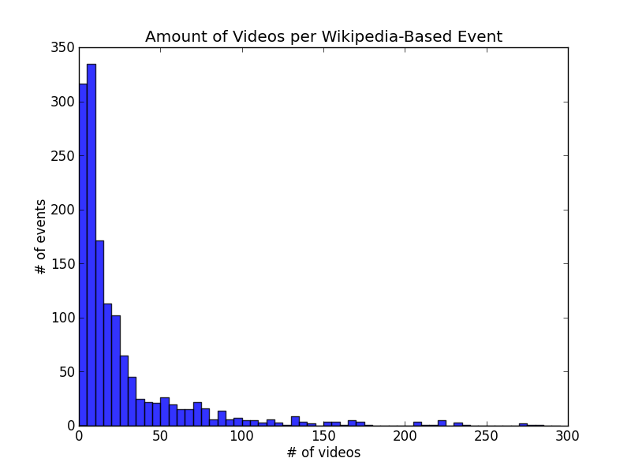
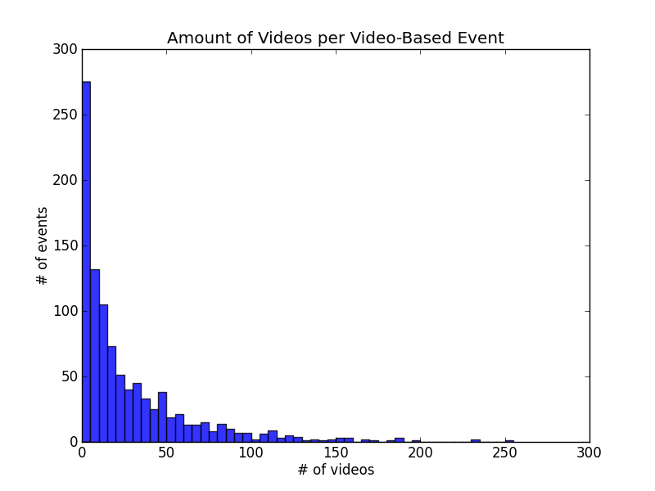
News Rover Content Collection
Daily Collection Statistics
Video Programs | Video Stories | Simultaneous Channels
~90 | ~400 | 12
Total Available Content (Aug 2012 – Date)
Video Programs | Video Stories | Video Events
62,840 | 268,782 | 990
Number of Videos per News Rover Event

Slide 9
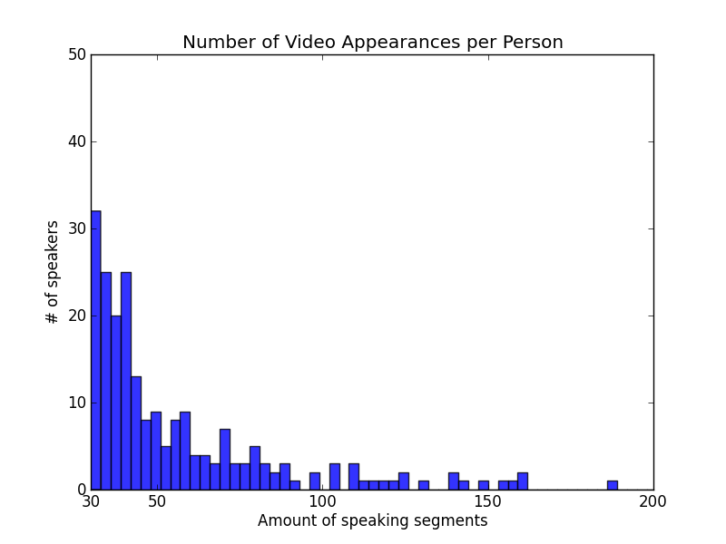
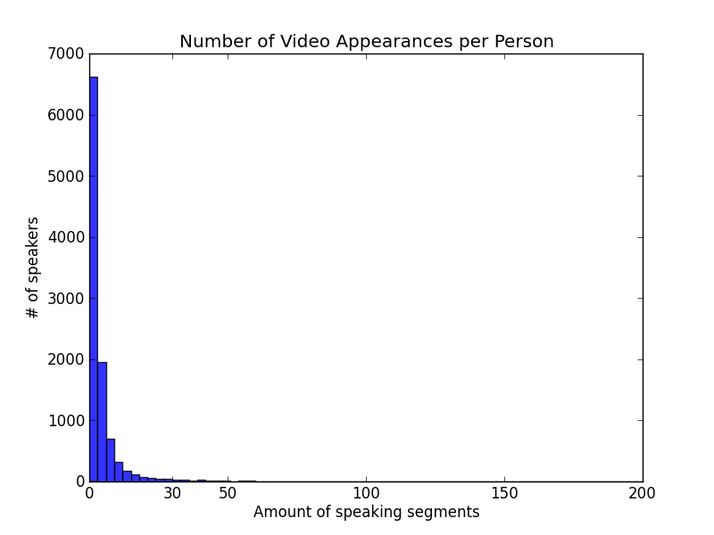
Major Players in the News
Major Players
Definition:
People within each news event that appear frequently on news broadcasts commenting on that event.
Current Statistics
10, 313 unique visual speakers in videos
44,464 video speech segments
Performance
86% precision
Frequent Speakers More Influential on Opinions?

Slide 10
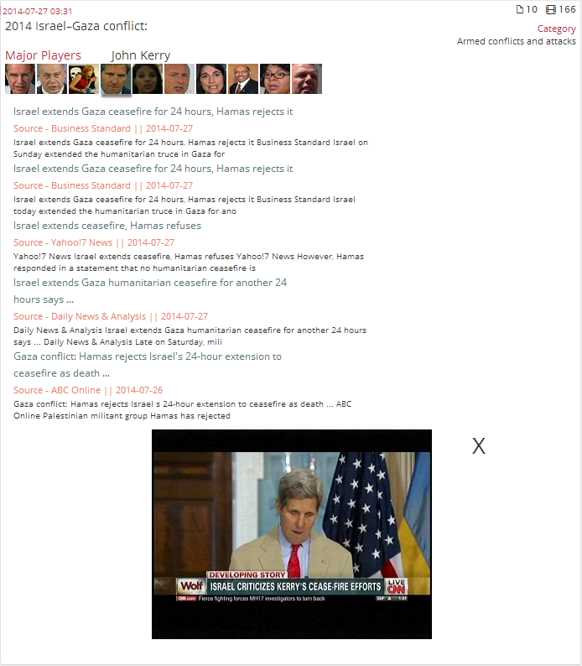
Finding “Major Players”
Methodology
Implementation
Video of selected “Major Player” discussing the event.

Slide 11
Explore News Rover!
rover.cs.columbia.edu

