Slide 1
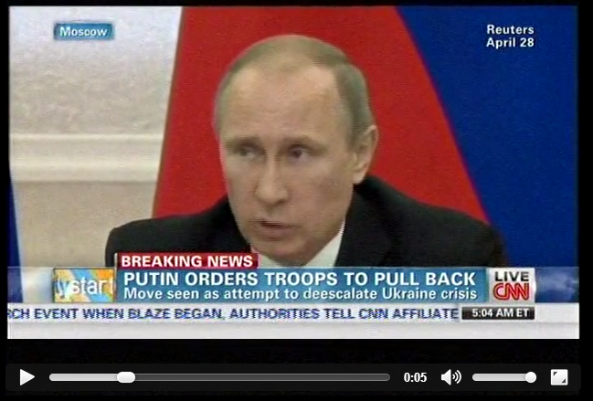
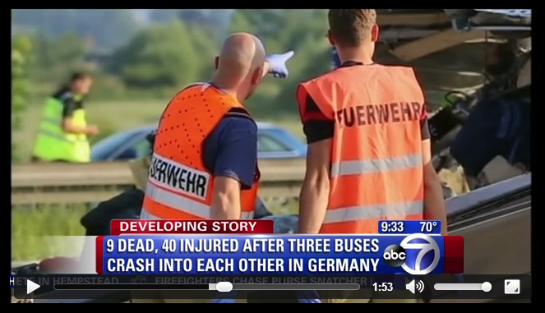
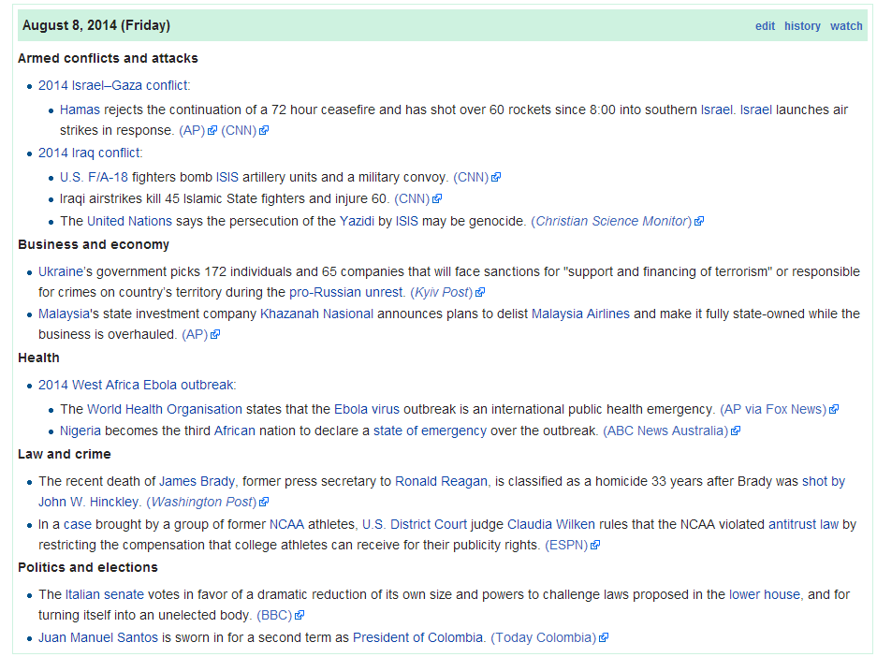
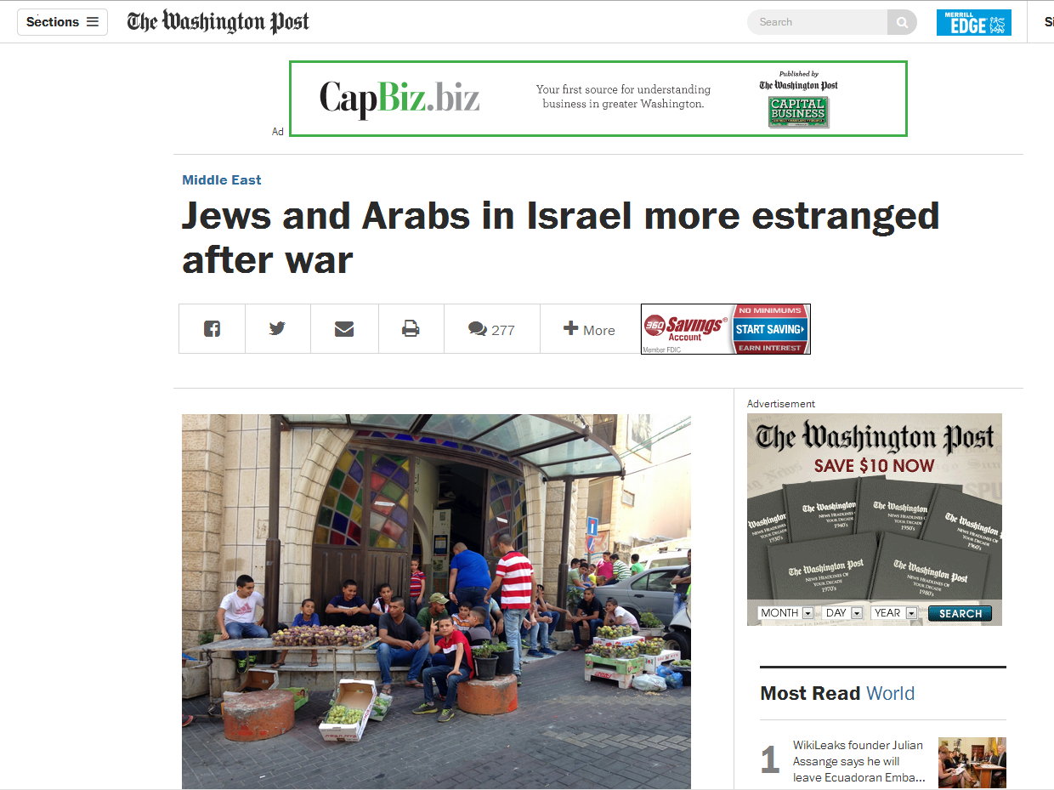
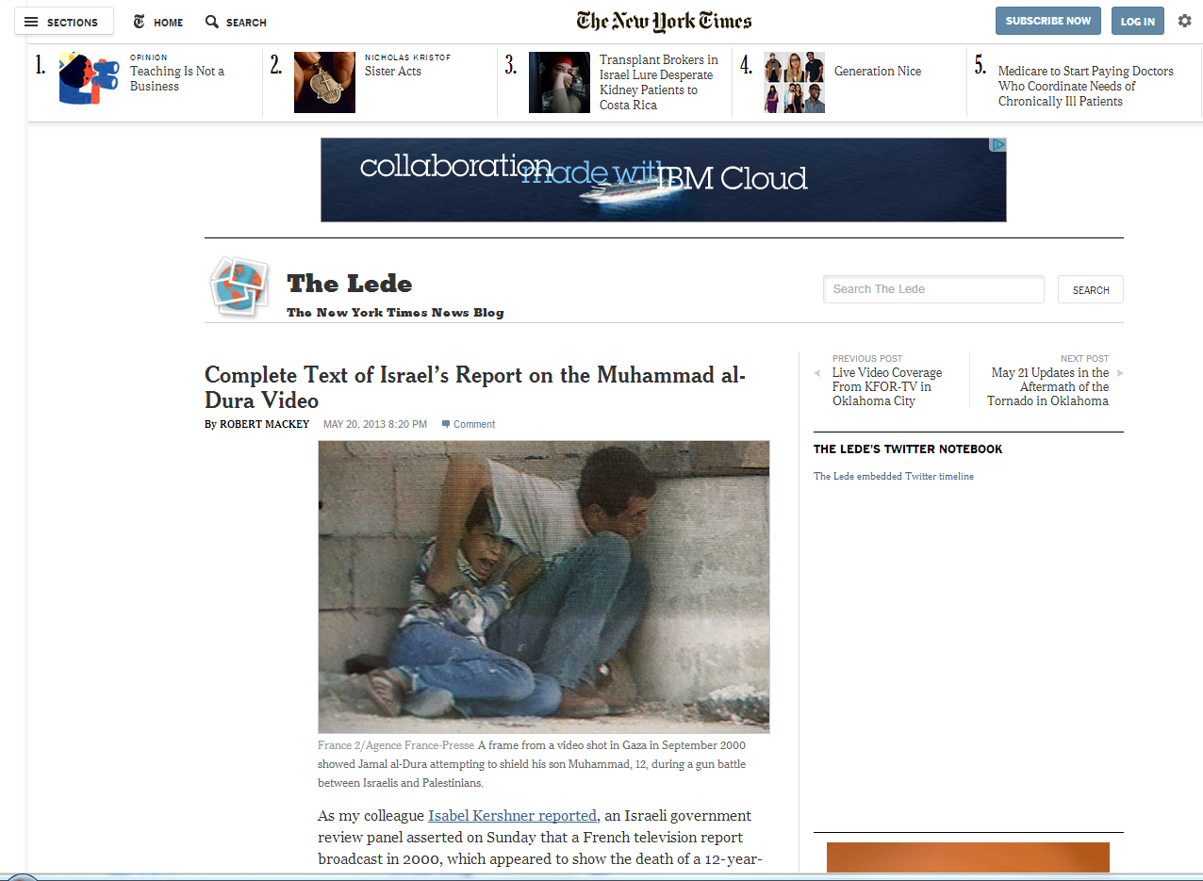
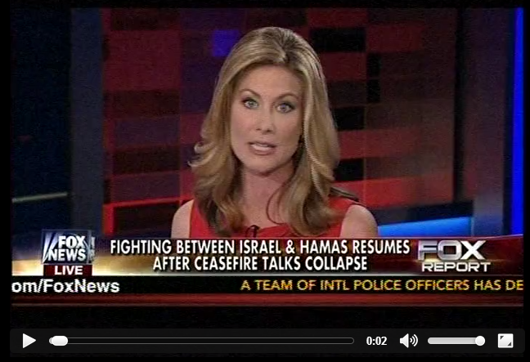
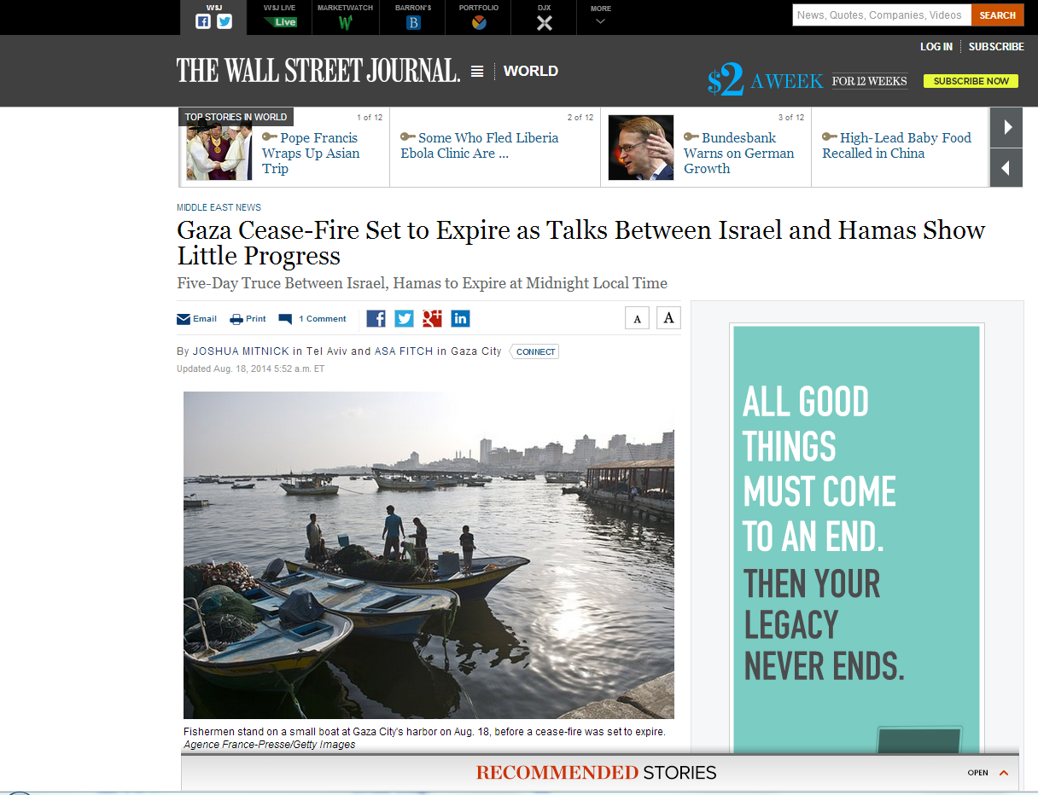
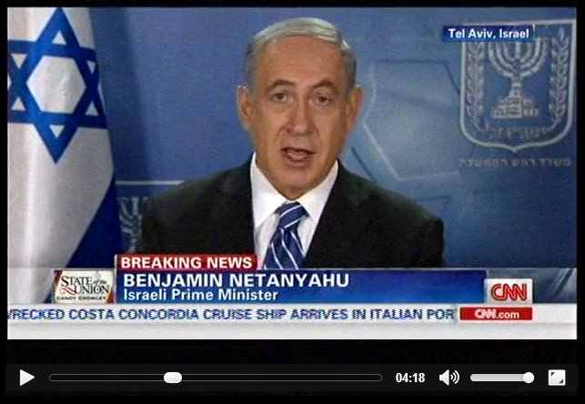
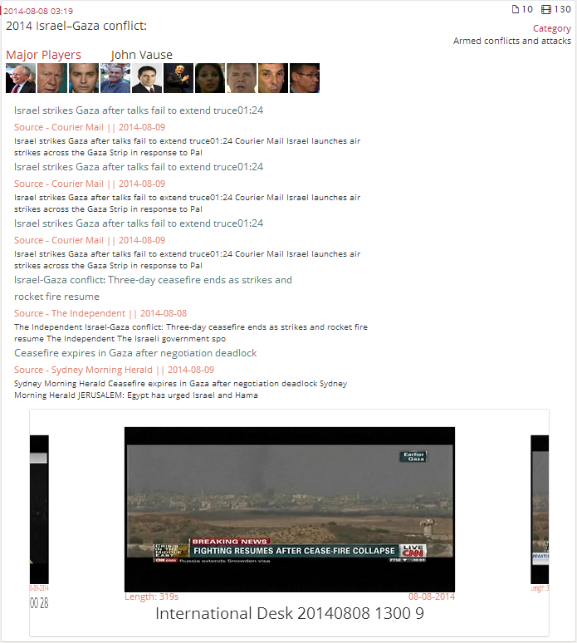
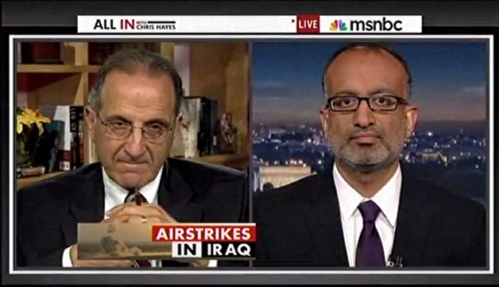
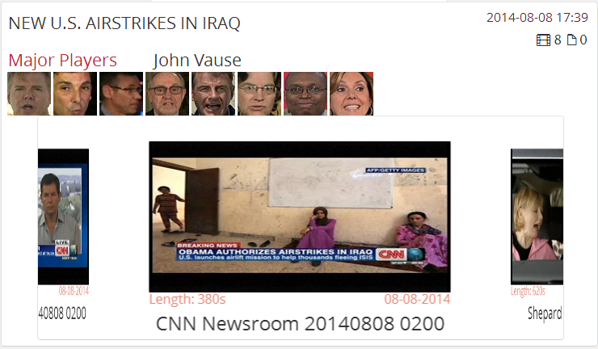
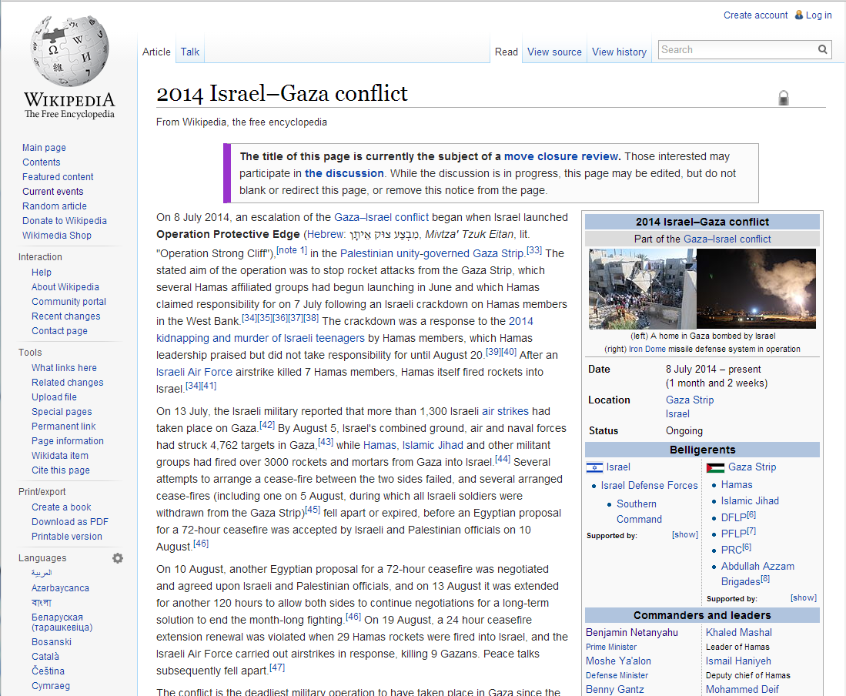
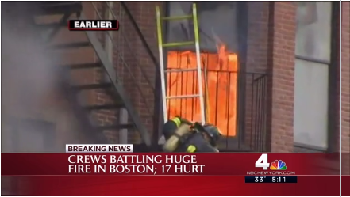
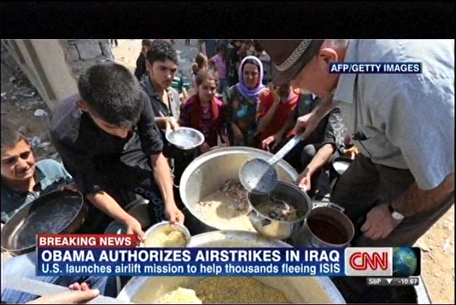
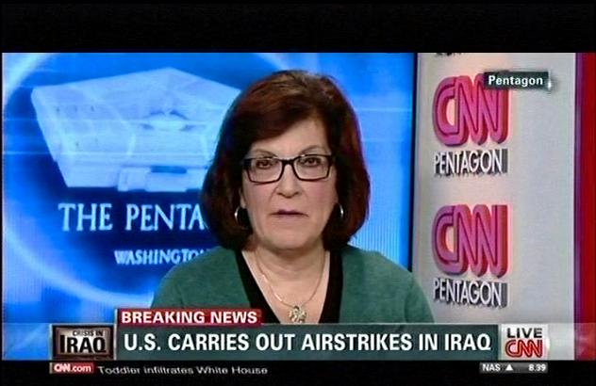
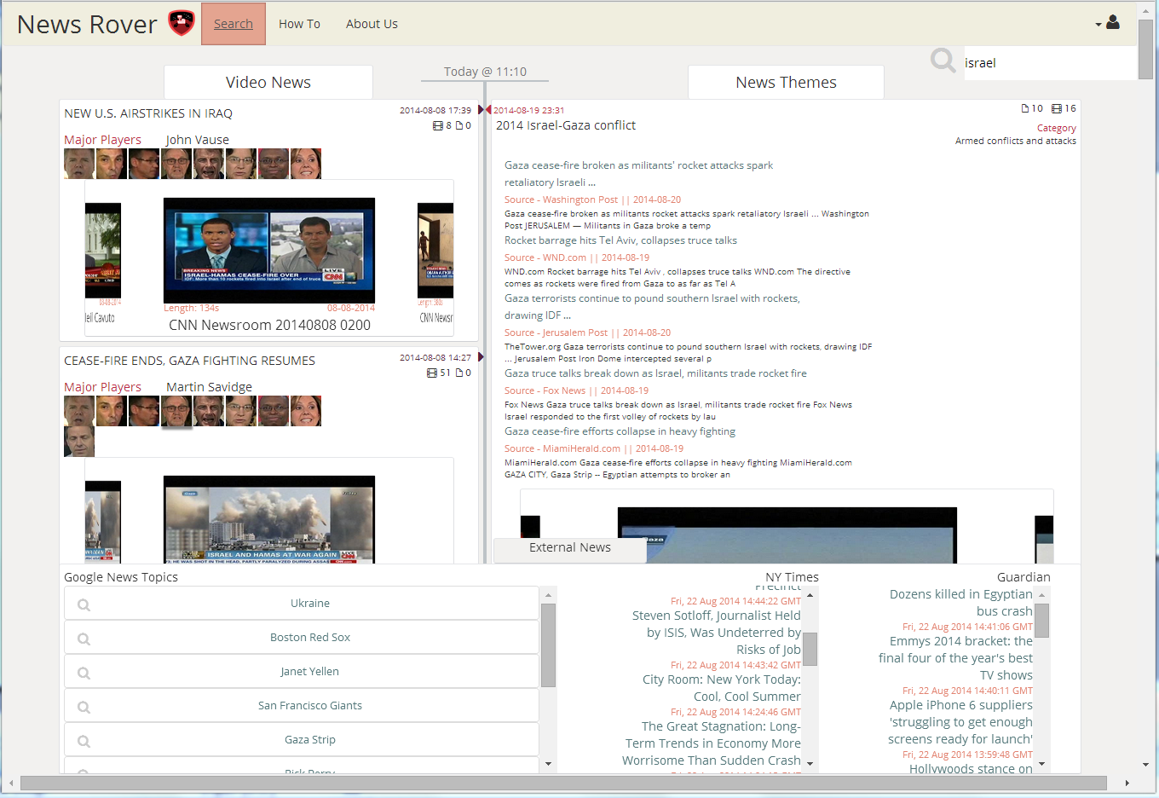
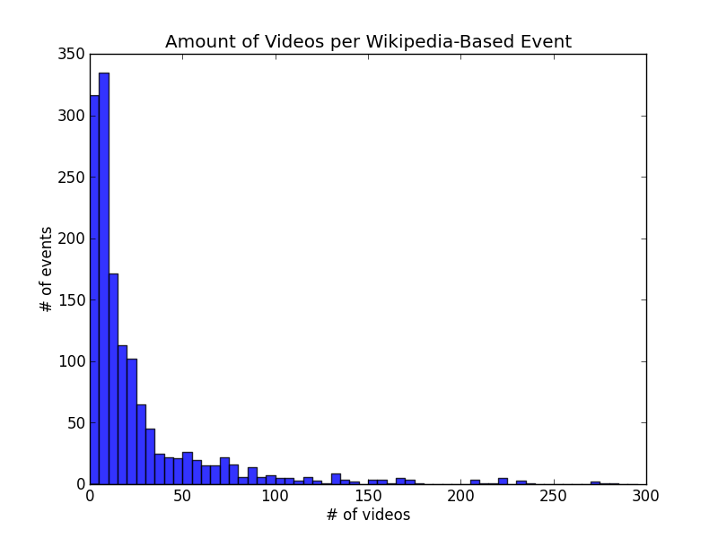
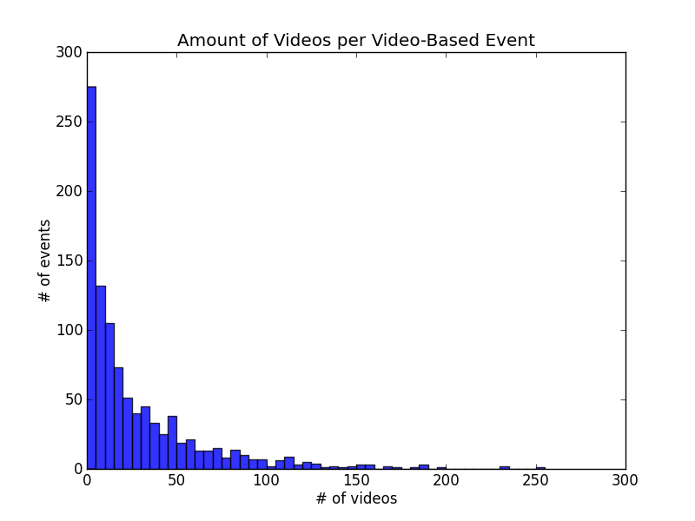
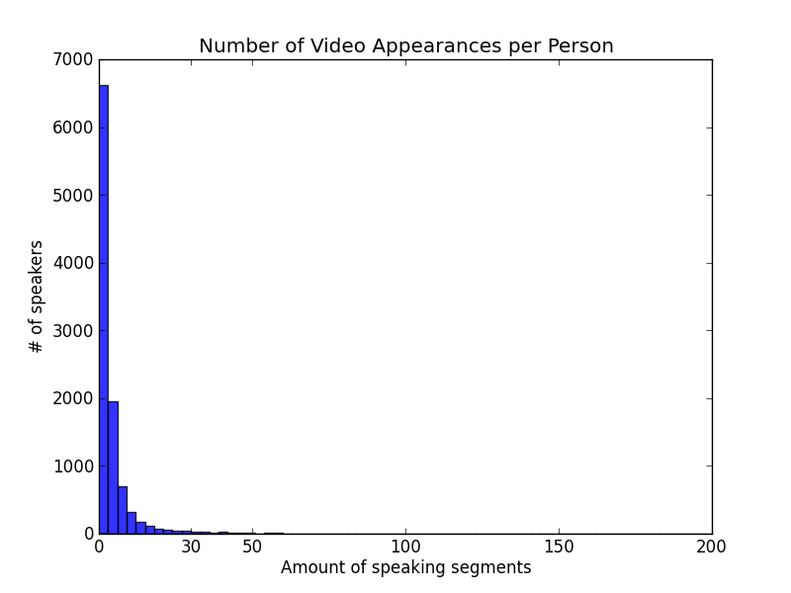
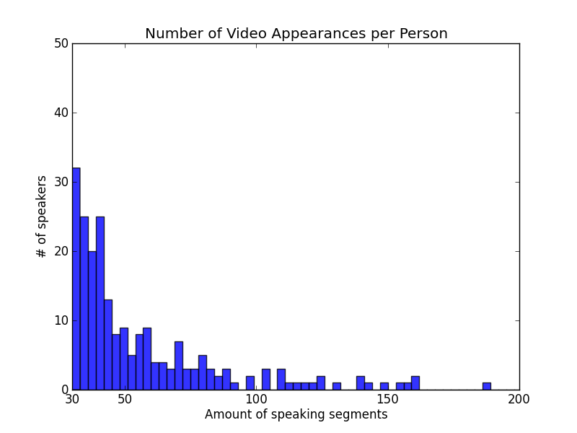
Digital Video & Multimedia Lab Columbia University
Hongzhi Li *, Brendan Jou *, Joseph G. Ellis *, Daniel Morozoff *, & Shih-Fu Chang
http://rover.cs.columbia.edu
Why News Rover?
Video-Based News Events
Wikipedia-Based News Events
Two Types of News Events
Find Candidate Events
Extract OCR Text as Video Feature
Event Discovery
News Rover Content
Long Running News Event : ”2014 Northern Iraq Offensive”
Wikipedia Current Events Page
Articles
Videos
Civilians Fleeing
Report of Killings
U.S. Airstrikes
Detect key phrases on-screen
Cluster News Videos Based
on Temporal and Text Similarity
Extracted Features
Generate Wikipedia Event
Breaking News Events
Generate News Rover Video Event
Event Description
Article Text
Breaking News Event
A specific event at a particular moment in time.
Long Running News Event:
A collection of related events and commentary that refers to a longer span of time.
Local News Event
Boston Building on Fire
Related Wikipedia Article
Link News Content based on Temporal and Text Similarity
News Rover Event Organization
Finding “Major Players”
Differences in Event Types
Video-Based Events
Wikipedia-Based Events
Video Events
Wikipedia Events
Address the need for coverage of breaking news events, and one-off stories that are not covered by curated news sources.
Addresses the need for coverage of long-term news stories that pertain to a broad topic or unify many smaller news events.
Real Examples
Real Examples
Ebola Patient Treated in NYC
2014 Northern Iraq Offensive
Video Event Characteristics
Specific event in time
Contain less videos than Wiki Events
Videos very closely related
Do not persist over time
Isreal-Hamas Cease Fire Voided
2014 West Africa Ebola Outbreak
Historic New York Snow Storm
Pro-Russian Conflict in Ukraine
Wikipedia Event Characteristics
Global topics
Can contain many videos
Videos are loosely related
Can persist for months or days at a time
New U.S. Airstrikes in Iraq
Israel-Gaza Conflict
Find “Major Players” in Video Events
Chuck Hagel
Barbara Starr
Columbia News Rover Website
News Rover Homepage
Event Visualization
Total System Content 2012-Date
Video Based
News Events
Event Time
Video Programs | Video Stories | Video Events | Visual Speakers
62,840 | 268,782 | 990 | 10,313
News Rover
Search
Event Title
Number of Videos per Event
Major Players
Related Articles
Wikipedia Based
News Events
Appearances of Major Players
News Videos
Current Google News
Topics and Articles
News Outlet RSS Feeds
Video Program Date and Time

